Slide 1
Controlling execution - iteration
A Lecture for the c++ Course
Each slide has its own narration in an audio file. For the explanation of any slide, click on the audio icon to start the narration.
The Professor‘s C++Course by Linda W. Friedman is licensed under a Creative Commons Attribution-NonCommercial-ShareAlike 3.0 Unported License.

Slide 2
Iteration constructs
Iteration ≡ Repetition ≡ Looping
In order to control iteration, we use one of three structured control statements.
for
while
do/while
The for structure is a counting loop.
The while structure is a “test before” loop.
The do/while structure is a “test after” loop.

Slide 3
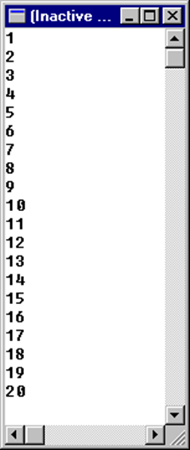
A counting program
We would like to write a program that will print the integers between 1 and 20, say, like the output shown here:
This is one way:
// A counting program using a for Loop
#include <iostream>
using namespace std;
int main(){
int count ;
for (count=1; count<=20; count++)
cout << count << endl;
return 0;
}

Slide 4
Another counting program
Two other programs that produce the same output. First this one:
// A counting program using a while/do Loop
#include <iostream>
using namespace std;
int main(){
int count;
count = 1;
while (count <=20){
cout << count << endl;
count = count + 1;
}
return 0;
}

Slide 5
Yet Another counting program
And this one
// A counting program using a do/while Loop
#include <iostream>
using namespace std;
int main(){
int count;
count = 1;
do {
cout << count << endl;
count = count + 1;
} while (count <=20);
return 0;
}

Slide 6
A summing program
We wish to write a program that will calculate the sum of the integers between 1 and 20.
// A Summing Program using a while/do Loop
#include <iostream>
using namespace std;
int main(){
int sum, count ;
sum = 0;
count = 1;
while (count <=20){
sum = sum + count;
count = count + 1;
}
cout << "The sum of the integers from 1 through 20 is ";
cout << sum << endl;
return 0;
}
The variables sum and count are accumulators.

Slide 7
A summing program
This program produces the same output. Which is better?
// A Summing Program using a for loop
#include <iostream>
using namespace std;
int main(){
int sum, count ;
sum = 0;
for (count=1; count<=20; count++)
sum = sum + count;
cout << "The sum of the integers from 1 through 20 is ";
cout << sum << endl;
return 0;
}

Slide 8
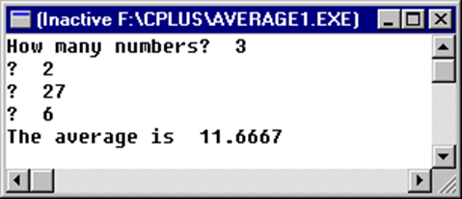
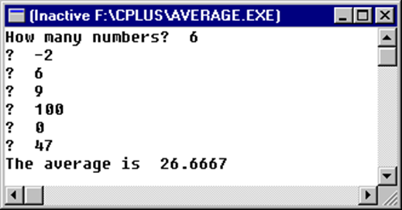
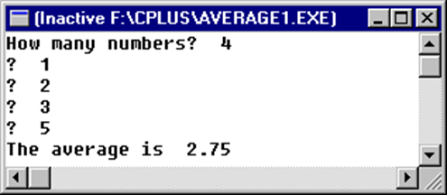
Just an average program
We have already seen a program that calculates the average of 3 particular numbers. That’s not very useful because it is not general enough.
We can do better now that we know how to loop. Here are some runs to show how the output from this program should look.

Slide 9
Just an average program
This program uses a for loop:
#include <iostream>
int main(){
int n, count;
float x, sum, avg;
sum = 0;
cout << "How many numbers? ";
cin >> n;
for (count=1; count<=n; count++){
cout << "? ";
cin >> x;
sum = sum + x;
}
avg = sum / n;
cout << "The average is " << avg << endl;
return 0
}
Do we really need to ask the user to count? Counting is something computers do really well!

Slide 10
Using a sentinel value
#include <iostream>
int main(){
int count;
float x, sum, avg;
const float EOD = -999; //end of data indicator
count = 0;
sum = 0;
cout << “First number?”; cin >> x;
while (x != EOD) {
sum += x;
count++;
cout << "? "; cin >> x;
}
avg = sum / count;
cout << "The average is " << avg << endl;
return 0;
}
Run this program yourself to see how it works.

Slide 11
Choosing a loop structure
When to use the while structure? When to use for?
How about do/while?

Slide 12
Branching – emergency use only
Discuss conditional vs. unconditional branching statements. The goto statement. Branching instructions should be used sparingly, only when absolutely necessary.
We will never use the unconditional goto statement, so we won’t even cover it here.
Conditional branching statements:
break
continue

Slide 13
break
The break statement is used to break out of a loop. Control is transferred to the first statement after the end of the loop.
Example. What is output?
// modified from the Deitel book
// Using the break statement in a for structure
#include <iostream>
using namespace std;
int main(){
int x;
for (x=1; x<=10; x++) {
if (x==5)
break; //break loop only if x is 5
cout << x << " ";
} //end for
cout << "\nBroke out of loop at x = " << x << endl;
cout<< endl << endl << endl;
return 0;
}

Slide 14
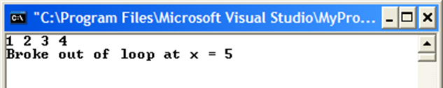
Example using break

Slide 15
Continue
The continue statement skips the remainder of the body of the loop, and continues the loop. Transfers control to “loop again.”
// This program is modified from the Deitel book,
#include <iostream>
using namespace std;
int main(){
int x;
for (x=1; x<=10; x++) {
if (x==5)
continue; // skip remaining code in loop only if x is 5
cout << x << " ";
}
cout << "\nUsed continue to skip printing the value 5 " << endl;
return 0;
}

Slide 16
Counting random digits
In the following example, the function rand() defined in the header file <stdlib> generates pseudorandom unsigned integers in the range of 0 to RAND_MAX. RAND_MAX is a constant which is also defined in <stdlib>.
// This program gets 1000 random numbers and tests them
#include <iostream>
#include <stdlib>
int main(){
int num0, num1, num2, num3, num4, num5, num6, num7, num8, num9;
num0=num1=num2=num3=num4=num5=num6=num7=num8=num9=0;
for (int i=0; i<1000; i++) {
int r = rand()%10; //remainder gives a one digit RN
//between 0 and 9
… program continues on next slide

Slide 17
Counting random digits
for (int i=0; i<1000; i++) {
int r = rand()%10; //remainder gives a one digit RN
//between 0 and 9
switch (r) {
case 0: num0++; break;
case 1: num1++; break;
case 2: num2++; break;
case 3: num3++; break;
case 4: num4++; break;
case 5: num5++; break;
case 6: num6++; break;
case 7: num7++; break;
case 8: num8++; break;
case 9: num9++; break;
default: cout << "Error: unexpected random number" << r;
} //end switch
} //end for
… program continues on next slide
Note: This program will be more efficient when we learn arrays.

Slide 18
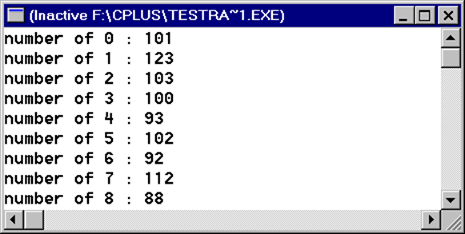
Counting random digits
… end of program
cout << "number of 0 : " << num0 << endl;
cout << "number of 1 : " << num1 << endl;
cout << "number of 2 : " << num2 << endl;
cout << "number of 3 : " << num3 << endl;
cout << "number of 4 : " << num4 << endl;
cout << "number of 5 : " << num5 << endl;
cout << "number of 6 : " << num6 << endl;
cout << "number of 7 : " << num7 << endl;
cout << "number of 8 : " << num8 << endl;
cout << "number of 9 : " << num9 << endl;
return 0;
} //end main

Slide 19
Review
What did we learn in this lecture? Plenty. Some terms to jog your memories:
Iteration
Looping
Repetition
Accumulator variable
Counter variable
For
Do/while
While/do
Sentinel value
Branching instruction
Unconditional branch
Conditional branch
Goto
Break statement
Continue statement
Pseudorandom number

